Slide 1
Problem solving with constructions
Task A: Identifying polygons from premade constructions
1) Each copy of this construction shows congruent circles. The centre of the left and rightmost circles are the endpoints of line segment FG.
e.g.
e.g.
60°
F
G
F
G
a) Draw on and label:
a right angle
an equilateral triangle
a regular hexagon
b) Draw on and label:
a rectangle
a parallelogram
2) This construction shows three congruent circles.
The endpoints of line segment FG are centres of two of the circles, and lie on the circumference of the third.
One intersection of the above two circles is centre of the third.
e.g.
a) Draw and label two equilateral triangles of different sizes.
e.g.
b) Draw and label two trapezia:
one an isosceles trapezium, and one a right-angle trapezium.
F
G
F
G
3) This construction shows two circles of different sizes.
The endpoints of line segment IJ are centres of two of the circles.
e.g.
I
J
I
J
a) Draw and label a kite, a bisector of IJ, and two isosceles triangles.
b) Draw and label two scalene triangles: one right angle and one non-right angle.

Slide 2
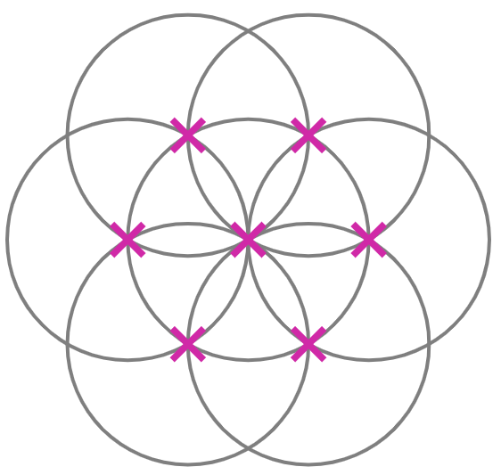
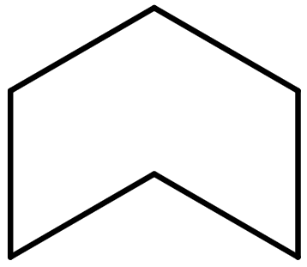
Problem solving with constructions
4) This construction shows seven congruent circles, each with their centres labelled with a cross.
e.g.
a) Find, draw, and label as many different polygons and angles as you can find.
Some examples of polygons include:
regular hexagon, irregular pentagon, trapezium, parallelogram, rhombus, arrowhead, equilateral triangle.
Some examples of angles include:
60°, 90°, 120°, 240°
b) Suggest a type of quadrilateral that cannot be drawn accurately from this construction.
Explain how you know it can’t be drawn accurately.
A square cannot be drawn accurately.
This is because all lengths that are of equal size are at an angle of either 30° or 60° to each other.
Task B: Constructing shapes
1) By constructing either part of or all of a six-petal flower, accurately construct the following shapes.
a)
b)
e.g.
e.g.
120°
Initial line segment of 4 cm
60°
Initial line segment of 5 cm
Initial line segment of 2 cm
c)
d)
e.g.
e.g.
240°
120°
60°
v2.3

Slide 3

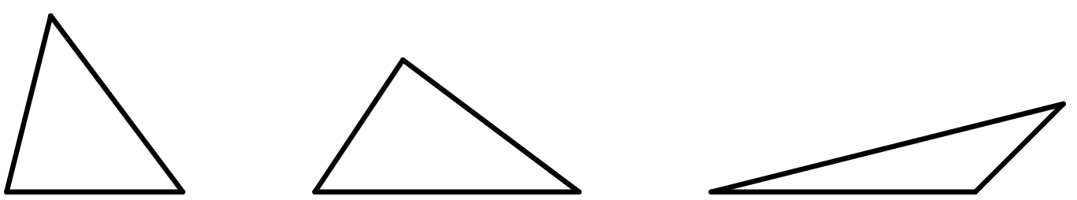
Problem solving with constructions
2) Many logos of real-world, famous companies are created using arcs and sectors of circles made from constructions.
By first using a six-petal flower template to help you plan, construct from scratch your own logo.
There are many possible logos that could be created.
Task C: Understanding properties of constructions
1) Accurately construct the perpendicular bisector to XY without any of your construction arcs and circles going outside the box.
2) Accurately construct the angle bisector to this 290° angle using the circle given and measure the size of the bisected angle.
145°
Y
X
3) The area of a triangle can be found using the formula
area =
× base × perpendicular height
By performing the appropriate construction, accurately measure the perpendicular height of each triangle to find its area.
a)
b)
c)
base
base
base
The perpendicular height of a) is equal to its base.
The perpendicular height of b) is half of its base.
The perpendicular height of c) is a third of its base.
The area of each triangle will depend on the scale with which the triangles have been printed.
Mathematics in Education and Industry

